Slide 1
AZ-203.1 Module 03: Create containerized solutions
Subtitle or speaker name
Notes:
In this module, you will cover:
Azure Kubernetes Service.
Deploy an AKS cluster.
Publish a container image to Azure Container Registry.
Create and run container images in Azure Container Instances.
Lab: Deploying compute workloads by using images and containers

Slide 2
Topics
Azure Kubernetes Service (AKS)
Deploy an AKS cluster
Publish a container image to Azure Container Registry
Create and run container images in Azure Container Instances
Lab: Deploying compute workloads by using images and containers
Notes:
These are the topics that will be covered in this module.

Slide 3
Lesson 01: Azure Kubernetes Service
Notes:
In this lesson, you will cover:
Kubernetes
Azure Kubernetes Service (AKS)
Access and Identity
Security
Networking
Storage
Scaling

Slide 4
Kubernetes
Manages container-based applications
Along with networking and storage requirements
Focused on application workloads instead of infrastructure components
Makes it easier to orchestrate large solutions using a variety of containers
Application containers
Storage containers
Middleware containers
Even more…
Applications are described declaratively
Use YAML files to describe application
Kubernetes handles management and deployment
Notes:
Kubernetes is a rapidly evolving platform that manages container-based applications and their associated networking and storage components. The focus is on the application workloads, not the underlying infrastructure components. Kubernetes provides a declarative approach to deployments, backed by a robust set of APIs for management operations.
You can build and run modern, portable, microservices-based applications that benefit from Kubernetes orchestrating and managing the availability of those application components. Kubernetes supports both stateless and stateful applications as teams progress through the adoption of microservices-based applications.
As an open platform, Kubernetes allows you to build your applications with your preferred programming language, OS, libraries, or messaging bus. Existing continuous integration and continuous delivery (CI/CD) tools can integrate with Kubernetes to schedule and deploy releases.

Slide 5



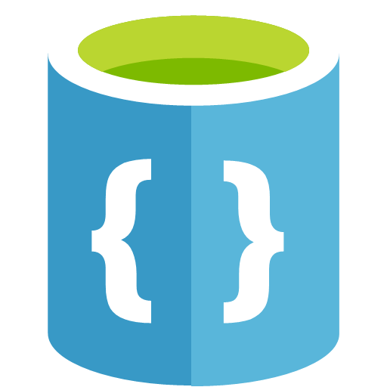
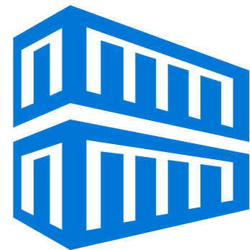
Kubernetes cluster architecture
Cluster master
Offers dedicated nodes that provide core Kubernetes services and orchestration
Nodes
Run application workloads
Azure-managed
Customer-managed
Cluster master
Node
API server
Scheduler
Node
kubelet
Container
runtime
Controller
manager
Kube-proxy
Container
etcd
Notes:
A Kubernetes cluster is divided into two components:
Cluster master nodes provide the core Kubernetes services and orchestration of application workloads.
Nodes run your application workloads.
Cluster master
When you create an Azure Kubernetes Service (AKS) cluster, a cluster master is automatically created and configured. This cluster master is provided as a managed Azure resource abstracted from the user and it contains the controller manager that runs vendor-specific logic for AKS. There is no cost for the cluster master, only the nodes that are part of the AKS cluster. Additionally, Azure manages the etcd database. In Kubernetes, etcd is used to store the state and the configuration of the Kubernetes clusters.
Nodes and node pools
To run your applications and supporting services, you need a Kubernetes node. An AKS cluster has one or more nodes, which is an Azure virtual machine (VM) that runs the Kubernetes node components (kube-proxy, kubelet) and the container runtime for that node.

Slide 6
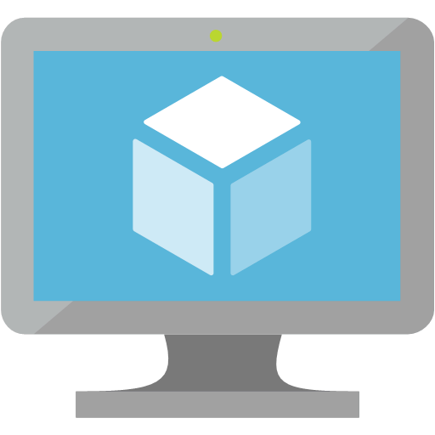
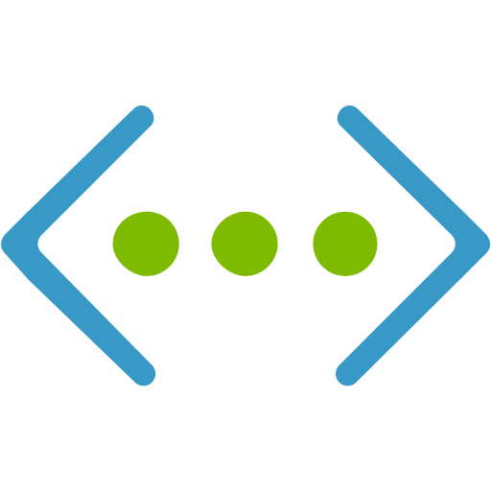
Kubernetes nodes
Each individual node is an Azure virtual machine (VM )
Contains Kubernetes node components needed to communicate with the cluster master and the internet
Contains the container runtime for your applications
In Azure Kubernetes Service (AKS), Docker is the container runtime
Azure virtual machine
kubelet
Container
runtime
Azure virtual network
Azure virtual network interface
Azure Disk
kube-proxy
Container
Azure Files
Notes:
The kubelet is the Kubernetes agent that processes the orchestration requests from the cluster master and scheduling of running the requested containers.
Virtual networking is handled by the kube-proxy on each node. The proxy routes network traffic and manages IP addressing for services and pods.
The container runtime is the component that allows containerized applications to run and interact with additional resources such as the virtual network and storage. In AKS, Docker is used as the container runtime.

Slide 7
Kubernetes terminology
Nodes
Individual VM running containerized applications
Pools
Groups of nodes with identical configurations
Pods
Single instance of an application
It’s possible for a pod to contain multiple containers within the same node
Deployments
One or more identical pods managed by Kubernetes
Manifests
YAML file describing a deployment
Notes:
Nodes
An AKS cluster has one or more nodes, which is an Azure virtual machine (VM) that runs the Kubernetes node components and container runtime.
In AKS, the VM image for the nodes in your cluster is currently based on Ubuntu Linux. When you create an AKS cluster or scale up the number of nodes, the Azure platform creates the requested number of VMs and configures them. There is no manual configuration for you to perform.
Node pools
Nodes of the same configuration are grouped together into node pools. A Kubernetes cluster contains one or more node pools. The initial number of nodes and size are defined when you create an AKS cluster, which creates a default node pool. This default node pool in AKS contains the underlying VMs that run your agent nodes.
Pods
Kubernetes uses pods to run an instance of your application. A pod represents a single instance of your application. Pods typically have a 1:1 mapping with a container, although there are advanced scenarios where a pod may contain multiple containers. These multi-container pods are scheduled together on the same node, and allow containers to share related resources.
A pod is a logical resource, but the container(s) are where the application workloads run. Pods are typically ephemeral, disposable resources, and individually scheduled pods miss some of the high availability and redundancy features that Kubernetes provides. Instead, pods are usually deployed and managed by Kubernetes Controllers, such as the Deployment Controller.
Manifests
A YAML file describing a deployment.
Deployments
A deployment represents one or more identical pods, managed by the Kubernetes Deployment Controller. A deployment defines the number of replicas (pods) to create, and the Kubernetes Scheduler ensures that if pods or nodes encounter problems, additional pods are scheduled on healthy nodes.
You can update deployments to change the configuration of pods, container image used, or attached storage. The Deployment Controller drains and terminates a given number of replicas, creates replicas from the new deployment definition, and continues the process until all replicas in the deployment are updated.

Slide 8
Azure Kubernetes Service (AKS)
Simple management of cluster of VMs by using Kubernetes
Removes infrastructure complication and planning
No cluster charges, just used resources
Secure, reliable, highly scalable
Supports node autoscaling to meet resource utilization
Supports in-place upgrade of clusters to the latest version of Kubernetes
Direct integration with Container Registry for Docker images
Azure Virtual Network integration for isolated network traffic
Notes:
Azure Kubernetes Service (AKS) provides a managed Kubernetes service that reduces the complexity for deployment and core management tasks, including coordinating upgrades. The AKS cluster masters are managed by the Azure platform, and you only pay for the AKS nodes that run your applications. AKS is built on top of the open-source Azure Container Service Engine (acs-engine).

Slide 9
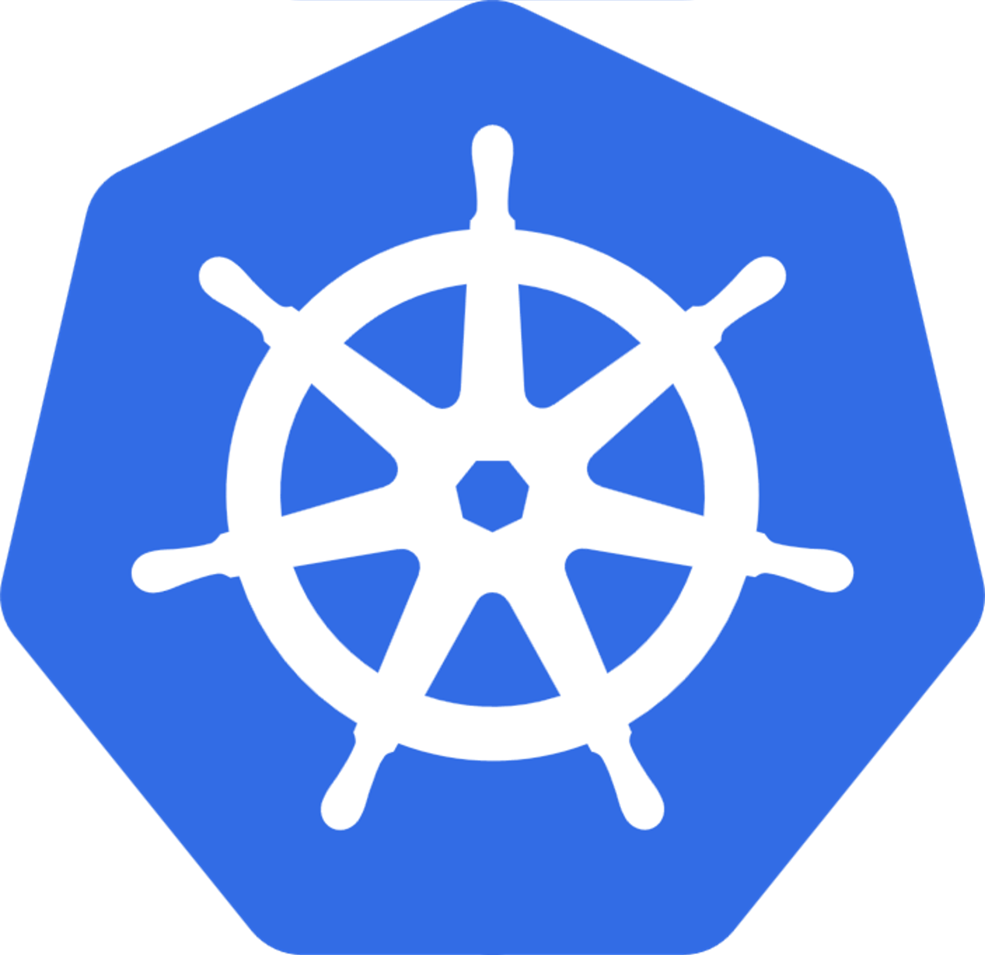
Package management with Helm
Helm charts are a package that makes it easier to manage applications
Helm packages contain:
Kubernetes YAML manifest(s)
Packaged version of application code
Can be stored locally or in a remote repository
AKS cluster
Helm client
Tiller
Service
Install
chart
Deploy resources
Pod
Notes:
A common approach to managing applications in Kubernetes is to use Helm. You can build and use existing public Helm charts that contain a packaged version of application code and Kubernetes YAML manifests to deploy resources. These Helm charts can be stored locally, or often in a remote repository, such as an Container Registry Helm chart repo.
To use Helm, a server component called Tiller is installed in your Kubernetes cluster. The Tiller manages the installation of charts within the cluster. The Helm client itself is installed locally on your computer, or it can be used within the Azure Cloud Shell. You can search for or create Helm charts with the client, and then install them to your Kubernetes cluster.

Slide 10


Namespaces
Logical grouping for resources such as pods and deployments
Used to divide a cluster and restrict access
Kubernetes includes built-in namespaces:
default
kube-system
kube-public
AKS cluster
Admin users
Engineering users
kube-system namespace
engineering namespace
Kube-dns
Blog service
Kube-proxy
kube-dashboard
Pod
Pod
Notes:
Kubernetes resources, such as pods and deployments, are logically grouped into a namespace. These groupings provide a way to logically divide an AKS cluster and restrict access to create, view, or manage resources. You can create namespaces to separate business groups, for example. Users can only interact with resources within their assigned namespaces.
When you create an AKS cluster, the following built-in namespaces are available:
default
This namespace is where pods and deployments are created by default when none is provided. In smaller environments, you can deploy applications directly into the default namespace without creating additional logical separations. When you interact with the Kubernetes API, such as with kubectl get pods, the default namespace is used when none is specified.
kube-system
This namespace is where core resources exist, such as network features like DNS and proxy, or the Kubernetes dashboard. You typically don't deploy your own applications into this namespace.
kube-public
This namespace is typically not used, but can be used for resources to be visible across the whole cluster, and can viewed by any users.
Of course, you can create any namespace you wish for your own services.

Slide 11
Access and identity
Service accounts
Managed by Kubernetes API
Credentials are stored as Kubernetes secrets
User accounts
Low-friction way to authenticate for human administrators or developers
Must use an external identity solution integrated into Kubernetes
For AKS, you can use Azure Active Directory
Notes:
One of the primary user types in Kubernetes is a service account. A service account exists in, and is managed by, the Kubernetes API. The credentials for service accounts are stored as Kubernetes secrets, which allows them to be used by authorized pods to communicate with the API Server. Most API requests provide an authentication token for a service account or a normal user account.
Normal user accounts allow more traditional access for human administrators or developers, not just services and processes. Kubernetes itself does not provide an identity management solution where regular user accounts and passwords are stored. Instead, external identity solutions can be integrated into Kubernetes. For AKS clusters, this integrated identity solution is Azure Active Directory.

Slide 12
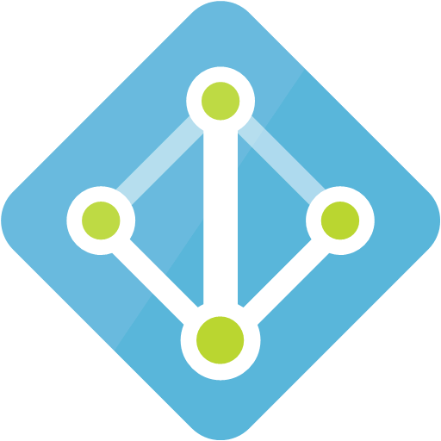
Azure AD integration
You can use Azure AD as an integrated identity solution
Authentication
prompt on first
kubectl connection
of session
Cluster master
Access to Kubernetes
resources can then be
scoped based on Azure
AD user or groups
Node
API server
kubelet
Container
runtime
Engineering
user
Container
Credentials verified against
Azure AD and
token issued
Azure AD
Notes:
The security of AKS clusters can be enhanced with the integration of Azure Active Directory (Azure AD). Built on decades of enterprise identity management, Azure AD is a multi-tenant, cloud-based directory and identity-management service that combines core directory services, application access management, and identity protection. With Azure AD, you can integrate on-premises identities into AKS clusters to provide a single source for account management and security.
With Azure AD-integrated AKS clusters, you can grant users or groups access to Kubernetes resources within a namespace or across the cluster. To obtain a kubectl configuration context, a user can run the az aks get-credentials command. When a user then interacts with the AKS cluster with kubectl, they are prompted to sign in with their Azure AD credentials. This approach provides a single source for user account management and password credentials. The user can only access the resources as defined by the cluster administrator.

Slide 13
Role-based access control (RBAC)
Assign users or groups permissions to manage Kubernetes
Permissions include:
Create or modify resources
View logs
Deploy application workloads
Permissions can be scoped to a single namespace or the entire AKS cluster
Permissions can be encapsulated in a RBAC role definition
Notes:
To provide granular filtering of the actions that users can perform, Kubernetes uses role-based access control (RBAC). This control mechanism lets you assign users, or groups of users, permission to do things like create or modify resources, or view logs from running application workloads. These permissions can be scoped to a single namespace, or granted across the entire AKS cluster. With Kubernetes RBAC, you create roles to define permissions, and then assign those roles to users with role bindings.
Azure role-based access controls (RBAC)
One additional mechanism for controlling access to resources is Azure role-based access control (RBAC). Kubernetes RBAC is designed to work on resources within your AKS cluster, and Azure RBAC is designed to work on resources within your Azure subscription. With Azure RBAC, you create a role definition that outlines the permissions to be applied. A user or group is then assigned this role definition for a particular scope, which could be an individual resource, a resource group, or across the subscription.

Slide 14
Security
Master security
Fully managed by Microsoft without any need for user input
Has a public IP and fully qualified domain name (FQDN) by default, and this can be managed by using RBAC or Azure AD
Node security
Automatically deployed with the latest OS security updates and configuration
Azure platform automatically applies OS security updates
If updates require a reboot, you must do this manually
Nodes are deployed into a virtual network private subnet
Cluster upgrades
You can trigger an AKS platform upgrade by using the existing orchestration tools
AKS safely drains each node and performs upgrades
Notes:
Kubernetes includes security components such as network policies and Secrets. Azure then adds in components such as network security groups and orchestrated cluster upgrades. These security components are combined to keep your AKS cluster running the latest OS security updates and Kubernetes releases, and with secure pod traffic and access to sensitive credentials.
Master security
In AKS, the Kubernetes master components are part of the managed service provided my Microsoft. Each AKS cluster has its own single-tenanted, dedicated Kubernetes master to provide the API Server, Scheduler, and other items. This master is managed and maintained by Microsoft.
Node security
AKS nodes are Azure virtual machines that you manage and maintain. The nodes run an optimized Ubuntu Linux distribution with the Docker container runtime. When an AKS cluster is created or scaled up, the nodes are automatically deployed with the latest OS security updates and configurations.
The Azure platform automatically applies OS security patches to the nodes on a nightly basis. If an OS security update requires a host reboot, that reboot is not automatically performed.
Cluster upgrades
For security and compliance, or to use the latest features, Azure provides tools to orchestrate the upgrade of an AKS cluster and components. This upgrade orchestration includes both the Kubernetes master and agent components. You can view a list of available Kubernetes versions for your AKS cluster. To start the upgrade process, you specify one of these available versions. Azure then safely cordons and drains each AKS node and performs the upgrade.

Slide 15
Networking security
Network Security Groups
Built-in Azure service to protect resources within virtual networks
Can define rules to manage:
Destination or source IP ranges
Portals
Protocols
Default rules are created to allow:
TLS traffic to Kubernetes API server
SSH access to individual nodes
Network security group (NSG) is automatically modified by AKS as you create services with:
Ingress routes
Port mappings
Load balancers
Notes:
Kubernetes includes security components such as network policies and Secrets. Azure then adds in components such as network security groups and orchestrated cluster upgrades. These security components are combined to keep your AKS cluster running the latest OS security updates and Kubernetes releases, and with secure pod traffic and access to sensitive credentials.
Network Security Groups
To filter the flow of traffic in virtual networks, Azure uses network security group rules. These rules define the source and destination IP ranges, ports, and protocols that are allowed or denied access to resources. Default rules are created to allow TLS traffic to the Kubernetes API server and for SSH access to the nodes. As you create services with load balancers, port mappings, or ingress routes, AKS automatically modifies the network security group for traffic to flow appropriately.

Slide 16
Networking
Kubernetes provides abstraction layer on top of Azure networking
Correlated services are created automatically
Example: if you create a Kubernetes load balancer, AKS will create an Azure load balancer
Notes:
To allow access to your applications, or for application components to communicate with each other, Kubernetes provides an abstraction layer to virtual networking. Kubernetes nodes are connected to a virtual network, and can provide inbound and outbound connectivity for pods. The kube-proxy component runs on each node to provide these network features.
In Kubernetes, Services logically group pods to allow for direct access via an IP address or DNS name and on a specific port. You can also distribute traffic by using a load balancer. More complex routing of application traffic can also be achieved with Ingress Controllers. Security and filtering of the network traffic for pods is possible with Kubernetes network policies.
The Azure platform also helps to simplify virtual networking for AKS clusters. When you create a Kubernetes load balancer, the underlying Azure load balancer resource is created and configured. As you open network ports to pods, the corresponding Azure network security group rules are configured. For HTTP application routing, Azure can also configure external DNS as new ingress routes are configured.

Slide 17
Networking connectivity
Services group pods together to provide network connectivity
Port 80
Pod
Cluster IP
Creates internal-only IP address for use within the cluster
Internal
traffic
Port 80
Port 80
Pod
Cluster IP
Port 80
Pod
Cluster IP
Port 31000
AKS node
Port 80
Pod
NodePort
Creates a port mapping on a specific node for direct access
Incoming
traffic
Port 31000
AKS node
NodePort
Port 80
Pod
Port 31000
AKS node
Port 80
Pod
NodePort
Notes:
To simplify the network configuration for application workloads, Kubernetes uses Services to logically group a set of pods together and provide network connectivity. The following service types are available:
Cluster IP
Creates an internal IP address for use within the AKS cluster. Good for internal-only applications that support other workloads within the cluster.
NodePort
Creates a port mapping on the underlying node that allows the application to be accessed directly with the node IP address and port.
A Pod is a wrapper for one or more containers. All containers in the same pod share resources and networking components to facilitate easy communication as if they were on the same machine.

Slide 18
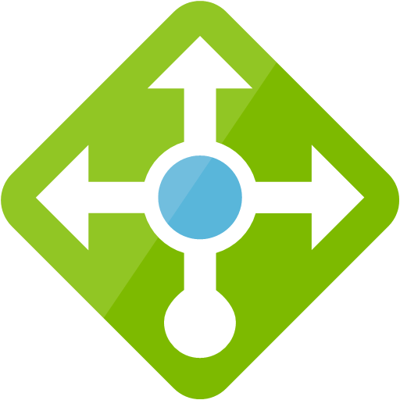
Networking connectivity (continued)
Services group pods together to provide network connectivity
LoadBalancer
Creates an Azure load balancer resource with an external IP address
Load
balancer
AKS node
DNS
Port 80
Port 80
AKS node
Pod
Port 80
AKS node
Pod
Incoming traffic
ExternalName
Creates a direct DNS entry
Notes:
To simplify the network configuration for application workloads, Kubernetes uses Services to logically group a set of pods together and provide network connectivity. The following Service types are available:
LoadBalancer
Creates an Azure load balancer resource, configures an external IP address, and connects the requested pods to the load balancer back-end pool. To allow customers traffic to reach the application, load balancing rules are created on the desired ports.
ExternalName
Creates a specific DNS entry for easier application access.

Slide 19

Storage
Local storage on the node is fast and simple to use
Local storage might not be available after the pod is deleted
Multiple pods may share data volumes
Storage could potentially be reattached to another pod
AKS cluster
Cluster master
Node
API server
Pod
Persistent volume claim
Persistent volume
Azure managed disk (Premium storage)
Azure Files
(Standard storage)
Notes:
Applications that run in Azure Kubernetes Service (AKS) may need to store and retrieve data. For some application workloads, this data storage can use local, fast storage on the node that is no longer needed when the pods are deleted. Other application workloads might require storage that persists on more regular data volumes within the Azure platform. Multiple pods might need to share the same data volumes, or reattach data volumes if the pod is rescheduled on a different node. Finally, you might need to inject sensitive data or application configuration information into pods.

Slide 20
Persistent storage volumes
Pods can use storage that is persistent
Storage exists beyond the lifetime of the pod
Storage can be a service, such as Azure Files or an Azure Managed Disk
Single node/pod
access
AKS cluster
Azure Managed Disk (Premium or Standard Storage)
Persistent volume
Azure Files
(Premium or Standard Storage)
Multiple concurrent
node/pod access
Notes:
Volumes are defined and created as part of the pod lifecycle and only exist until the pod is deleted. Pods often expect their storage to remain if a pod is rescheduled on a different host during a maintenance event, especially in StatefulSets. A persistent volume (PV) is a storage resource created and managed by the Kubernetes API that can exist beyond the lifetime of an individual pod.
Azure Disks or Files are used to provide the PersistentVolume. As noted in the previous section on Volumes, the choice of Disks or Files is often determined by the need for concurrent access to the data or the performance tier.

Slide 21
Scaling
Applications might grow beyond the capacity of a single pod
Kubernetes has built-in autoscalers to automatically create instances when they are needed
Horizontal pod autoscaler
Automatically scales replicas based on metrics
Cluster autoscaler
Adjusts the number of nodes based on the requested compute resources
AKS cluster
Cluster Autoscaler
Scale out
Nod
Node
Node
Node
Node
Horizontal Pod Autoscaler
Scale out
Pod
Pod
Pod
Pod
Pod
Notes:
As you run applications in AKS, you might need to increase or decrease the amount of compute resources. As the number of application instances you need change, the number of underlying Kubernetes nodes might also need to change. You also might need to quickly provision a large number of additional application instances.
Horizontal pod autoscaler
Kubernetes uses the horizontal pod autoscaler (HPA) to monitor the resource demand and automatically scale the number of replicas. By default, the horizontal pod autoscaler checks the Metrics API every 30 seconds for any required changes in replica count. When changes are required, the number of replicas is increased or decreased accordingly.
Cluster autoscaler
To respond to changing pod demands, Kubernetes has a cluster autoscaler that adjusts the number of nodes based on the requested compute resources in the node pool. By default, the cluster autoscaler checks the API server every 10 seconds for any required changes in node count. If the cluster autoscale determines that a change is required, the number of nodes in your AKS cluster is increased or decreased accordingly.

Slide 22
Scaling to Azure Container Instances
If you need to rapidly grow your AKS cluster, you can create new pods in Azure Container Instances
AKS cluster
Azure Container
Instances
Cluster autoscaler
Scale out
Rapid burst
scaling
Nod
Node
Node
Pod
Pod
Pod
Pod
Horizontal pod autoscaler
Scale out
Pod
Pod
Pod
Pod
Pod
Notes:
Burst to Container Instances
To rapidly scale your AKS cluster, you can integrate with Azure Container Instances. Kubernetes has built-in components to scale the replica and node count. However, if your application needs to scale rapidly, the horizontal pod autoscaler may schedule more pods than can be provided by the existing compute resources in the node pool. If configured, this scenario would then trigger the cluster autoscaler to deploy additional nodes in the node pool, but it might take a few minutes for those nodes to successfully provision and allow the Kubernetes scheduler to run pods on them.

Slide 23
Lesson 02: Deploy an AKS cluster
Notes:
In this lesson, you will cover:
Deploying to AKS by using Azure CLI.
Deploying Application to AKS.
Deploying an AKS cluster by using the Azure portal.

Slide 24
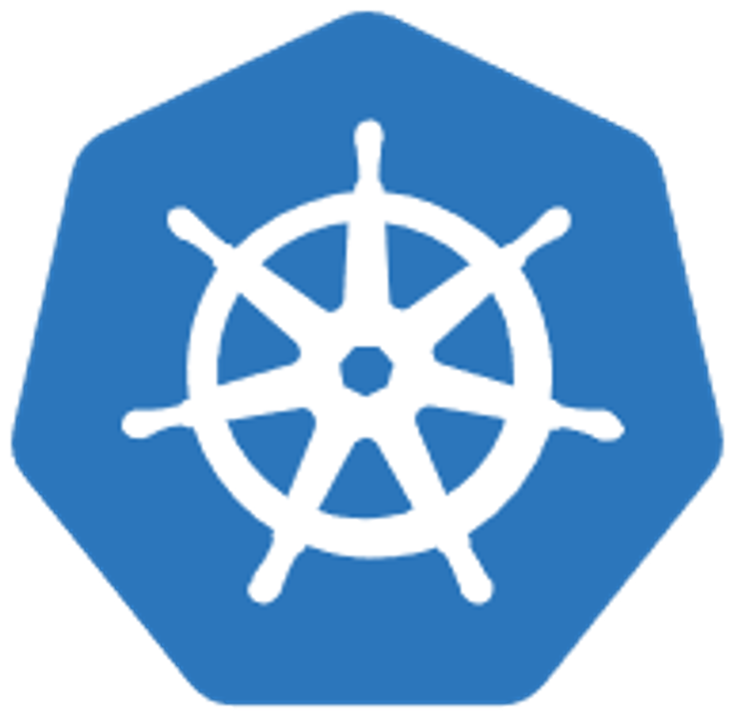
Deploying to AKS by using Azure CLI
# Create resource group
az group create --name mygroup --location eastus
# Create AKS cluster
az aks create --resource-group mygroup --name mycluster --node-count 1 --enable-addons monitoring --generate-ssh-keys
Notes:
Create a resource group with the az group create command. An Azure resource group is a logical group in which Azure resources are deployed and managed. When you create a resource group, you are asked to specify a location. This location is where your resources run in Azure.
Use the az aks create command to create an AKS cluster. The example creates a cluster with one node and enables features such as Container health monitoring by using the
--enable-addons monitoring parameter.

Slide 25
Connecting a kubectl client to AKS
# Install kubectl command line client locally
az aks install-cli
# Get credentials
az aks get-credentials --resource-group mygroup --name mycluster
# Get a list of cluster nodes
kubectl get nodes
Notes:
To manage a Kubernetes cluster, use kubectl, the Kubernetes command-line client.
Note: If you're using Azure Cloud Shell, kubectl is already installed. If you want to install it locally, use the az aks install-cli command.
The az aks get-credentials command downloads credentials and configures the Kubernetes CLI to use them.
To verify the connection to your cluster, use the kubectl get command to return a list of the cluster nodes. It can take a few minutes for the nodes to appear.

Slide 26
Kubernetes manifest
apiVersion: apps/v1
kind: Deployment
metadata:
name: nginx-deployment
spec:
selector:
matchLabels:
app: nginx
replicas: 2 # tells deployment to run 2 pods matching the template
template:
metadata:
labels:
app: nginx
spec:
containers:
- name: nginx
image: nginx:1.7.9
ports:
- containerPort: 80
Notes:
A Kubernetes manifest file defines a desired state for the cluster, including what container images should be running.
This YAML file describes a deployment that runs the nginx:1.7.9 Docker image.

Slide 27
Deploying application to AKS
# Get a list of cluster nodes
kubectl get nodes
# Run the application
kubectl apply -f example.yaml
# Monitor progress of the deployment
kubectl get service nginx-deployment -watch
# View pods related to this deployment
kubectl get pods -l app=nginx
Notes:
To verify the connection to your cluster, use the kubectl get command with the nodes noun to return a list of the cluster nodes. It can take a few minutes for the nodes to appear.
Use the kubectl apply command to run the application described in the manifest.
As the application is run, a Kubernetes service is created that exposes the application front end to the internet. This process can take a few minutes to complete.
Use the kubectl get command with the service noun to monitor the progress of the deployment.
Finally, use the kubectl get command with the pods noun to view the list of pods related to your deployment.

Slide 28
Demo: Deploying to AKS by using Azure CLI
Notes:
In this demo, an AKS cluster is deployed by using the Azure CLI. A multi-container application consisting of web front end and a Redis instance is then run on the cluster. After it is completed, the application is accessible over the internet.
This revision of the course does not ship with demo instructions. For each demo, you will be given a list of specific tasks you should demonstrate to your students. The flow, content and structure of your demo is left to you to decide as an instructor.
In this demo, you should show students how to:
Use the Azure CLI to create an AKS cluster.
Use the kubectl client to deploy a workload to the cluster.

Slide 29
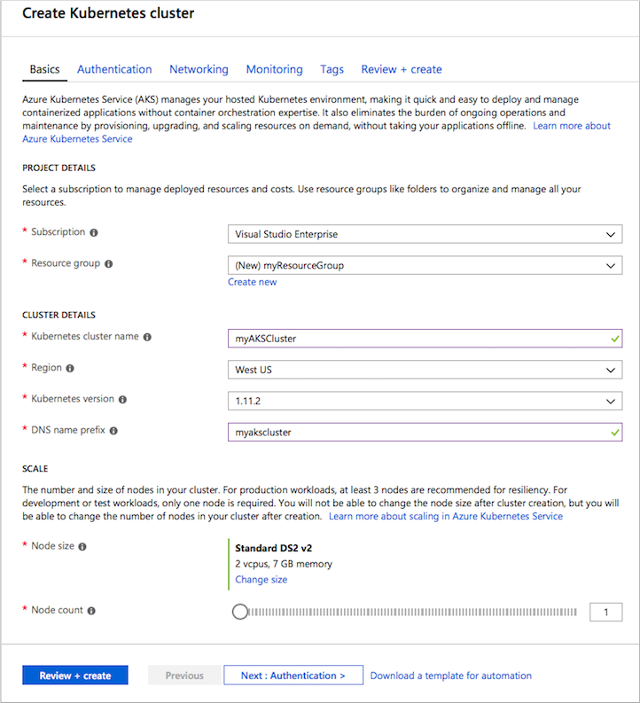
Deploying an AKS cluster by using the Azure portal
Notes:
You can use the portal to create and configure an AKS cluster in a manner similar to using any other tool (PowerShell, CLI, or SDKs). You can examine the same configuration options from the CLI in the portal interface shown here.
After the cluster is created, you can deploy applications to the cluster.

Slide 30
Demo: Deploying an AKS cluster by using the Azure portal
Notes:
This revision of the course does not ship with demo instructions. For each demo, you will be given a list of specific tasks you should demonstrate to your students. The flow, content and structure of your demo is left to you to decide as an instructor.
In this demo, you should show students how to:
Use the Azure Portal to create a new AKS cluster.
Change the scale of the AKS cluster using the AKS blade.

Slide 31
Lesson 03: Publish a container image to Container Registry
Notes:
In this lesson, you will cover:
Azure Container Registry (ACR).
Azure Container Registry Build (ACR Build).
Deploy an image to Container Registry using Azure CLI.

Slide 32
Azure Container Registry (ACR)
Managed Docker registry service
Based on the open-source Docker Registry 2.0
Stores and manages private Docker container images
Tight integration with multiple Azure services that support these Docker containers:
Azure App Service
Azure Batch
Azure Service Fabric
Azure Kubernetes Service
Notes:
Container Registry is a managed Docker registry service based on the open-source Docker Registry 2.0. Create and maintain Azure container registries to store and manage your private Docker container images.
Use container registries in Azure with your existing container development and deployment pipelines. Use Azure Container Registry Build (ACR Build) to build container images in Azure. Build on demand, or fully automate builds with source code commit and base image update build triggers.

Slide 33
Key terminology
Registry
A service that stores container images
Repository
A group of related container images
Image
A point-in-time snapshot of a Docker-compatible container
Container
A software application and its dependencies running in an isolated environment
Notes:
Registry
Create one or more container registries in your Azure subscription. Registries are available in three SKUs: Basic, Standard, and Premium, each of which support webhook integration, registry authentication with Azure Active Directory, and delete functionality. Take advantage of local, network-close storage of your container images by creating a registry in the same Azure location as your deployments. Use the geo-replication feature of Premium registries for advanced replication and container image distribution scenarios. A fully qualified registry name has the form myregistry.azurecr.io.
You control access to a container registry using an Azure Active Directory-backed service principal or a provided admin account. Run the standard Docker login command to authenticate with a registry.
Repository
A registry contains one or more repositories, which store groups of container images. Container Registry supports multilevel repository namespaces. With multilevel namespaces, you can group collections of images related to a specific app, or a collection of apps to specific development or operational teams. For example:
myregistry.azurecr.io/aspnetcore:1.0.1 represents a corporate-wide image
myregistry.azurecr.io/warrantydept/dotnet-build represents an image used to build .NET apps, shared across the warranty department
myregistry.azurecr.io/warrantydept/customersubmissions/web represents a web image, grouped in the customer submissions app, owned by the warranty department
Image
Stored in a repository, each image is a read-only snapshot of a Docker-compatible container. Azure container registries can include both Windows and Linux images. You control image names for all your container deployments. Use standard Docker commands to push images into a repository or pull an image from a repository. In addition to container images, Container Registry stores related content formats such as Helm charts, used to deploy applications to Kubernetes.
Container
A container defines a software application and its dependencies wrapped in a complete filesystem including code, runtime, system tools, and libraries. Run Docker containers are based on Windows or Linux images that you pull from a container registry. Containers running on a single machine share the operating system kernel. Docker containers are fully portable to all major Linux distros, macOS, and Windows.

Slide 34
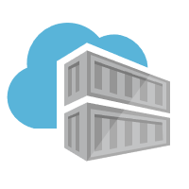

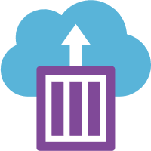

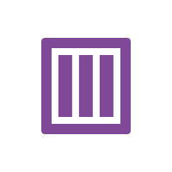

Docker containers and registries
Registry
Container
Repository
Docker host
Notes:
Let’s examine how container repositories function in the Docker ecosystem.
In the Docker ecosystem, a container registry contains a set of container repositories. Container repositories function like code source-control repositories as they store versioned copies of a container image. A machine running Docker can pull a container image from a registry and create a new container instance from the image.

Slide 35
Container Registry SKUs
SKU | Description
Basic | Ideal for developers learning about Container Registry Same programmatic capabilities as Standard and Premium, however, there are size and usage constraints
Standard | Same capabilities as Basic, but with increased storage limits and image throughput. Should satisfy the needs of most production scenarios.
Premium | Higher limits on constraints, such as storage and concurrent operations, including enhanced storage capabilities to support high-volume scenarios. Adds features like geo-replication for managing a single registry across multiple regions
Notes:
Container Registry is available in several different SKUs that provide predictable pricing and options for aligning to capacity and usage patterns of a private Docker registry in Azure.
Basic
A cost-optimized entry point for developers learning about Container Registry. Basic registries have the same programmatic capabilities as Standard and Premium (Azure Active Directory authentication integration, image deletion, and web hooks), however, there are size and usage constraints.
Standard
The Standard registry offers the same capabilities as Basic, but with increased storage limits and image throughput. Standard registries should satisfy the needs of most production scenarios.
Premium
Premium registries have higher limits on constraints, such as storage and concurrent operations, including enhanced storage capabilities to support high-volume scenarios. In addition to higher image throughput capacity, Premium adds features like geo-replication for managing a single registry across multiple regions, maintaining a network-close registry to each deployment.

Slide 36
Create a container registry by using Azure CLI
# Create a Container Registry instance
az acr create --resource-group <group> --name <acr-name> --sku Basic
# Login to Container Registry
az acr login --name <acrName>
Notes:
Create a Container Registry instance by using the az acr create command. The registry name must be unique within Azure and must contain 5-50 alphanumeric characters.
When the registry is created, the output is similar to the following:
{
"adminUserEnabled": false,
"creationDate": "2017-09-08T22:32:13.175925+00:00",
"id": "/subscriptions/00000000-0000-0000-0000-000000000000/resourceGroups/myResourceGroup/providers/Microsoft.ContainerRegistry/registries/myContainerRegistry007",
"location": "eastus",
"loginServer": "myContainerRegistry007.azurecr.io",
"name": "myContainerRegistry007",
"provisioningState": "Succeeded",
"resourceGroup": "myResourceGroup",
"sku": {
"name": "Basic",
"tier": "Basic"
},
"status": null,
"storageAccount": null,
"tags": {},
"type": "Microsoft.ContainerRegistry/registries"
}
Before pushing and pulling container images, you must log in to the Container Registry instance. To do so, use the az acr login command. The command returns a Login Succeeded message after it is completed.

Slide 37
Build a Docker image for Container Registry
# Pull existing Docker image
docker pull microsoft/aci-helloworld
# Obtain the full login server name of the Container Registry instance
az acr list --resource-group <group> --query "[].{acrLoginServer:loginServer}" --output table
# Tag image with full login server name prefix
docker tag microsoft/aci-helloworld <acrLoginServer>/aci-helloworld:v1
# Push image to Container Registry
docker push <acrLoginServer>/aci-helloworld:v1
Notes:
To push an image to an Azure Container registry, you must first have an image. If you don't yet have any local container images, you can pull an existing image from Docker Hub.
Before you can push an image to your registry, you must tag it with the fully qualified name of your Container Registry login server. Tag the image using the docker tag command.
Use Docker push to push the image to the Container Registry instance.

Slide 38
View a deployed image in Container Registry by using Azure CLI
# List container images
az acr repository list --name <acrName> --output table
# List the tags on the aci-helloworld repository
az acr repository show-tags --name <acrName> --repository aci-helloworld --output table
Notes:
Use the az acr repository list command to list all the repositories in the registry. The output should appear similar to the following:
Result
----------------
aci-helloworld
Use the az acr repository show-tags command to list all of the tags within the repository:
Result
--------
v1

Slide 39
Deploy an image to Container Registry by using Azure CLI
# Enable admin user
az acr update --name <acrName> --admin-enabled true
# Query for the password
az acr credential show --name <acrName> --query "passwords[0].value"
# Deploy container image
az container create --resource-group <group> --name acr-quickstart --image <acrLoginServer>/aci-helloworld:v1 --cpu 1 --memory 1 --registry-username <acrName> --registry-password <acrPassword> --dns-name-label <fqdn> --ports 80
# View container FQDN
az container show --resource-group myResourceGroup --name acr-quickstart ` --query instanceView.state
Notes:
To deploy a container instance from the registry you created, you must provide the registry credentials when you deploy it.
In production scenarios, you should use a service principal for container registry access, but in these examples, we will enable the admin user on your registry.
After admin is enabled, the username is the same as your registry name and you can retrieve the password by using the az acr credential show command.
You can use the az container create command to deploy your container image. In this example, we deploy a container with 1 CPU core and 1 GB of memory.

Slide 40
Demo: Deploy an image to Container Registry by using Azure CLI
Notes:
Container Registry is a managed Docker container registry service used for storing private Docker container images. This guide details creating an Container Registry instance by using the Azure CLI, pushing a container image into the registry, and finally, deploying the container from your registry into Azure Container Instances (ACI).
This revision of the course does not ship with demo instructions. For each demo, you will be given a list of specific tasks you should demonstrate to your students. The flow, content and structure of your demo is left to you to decide as an instructor.
In this demo, you should show students how to:
Create a Dockerfile for a Docker image.
Use the build feature of the Container Registry service to build the Docker image and deploy it to Container Registry.

Slide 41
Azure Container Registry Build (ACR Build)
Suite of features within Container Registry that provides streamlined and efficient Docker container image builds in Azure
Offloads docker build operations to Azure
Replaces manual build by using Docker tools on your local machine
Build on demand
Fully automate builds with source code commit and base image update build triggers
Notes:
ACR Tasks is a suite of features within Container Registry that provides streamlined and efficient Docker container image builds in Azure. ACR Build is one of the tasks available in ACR Tasks.

Slide 42



Building images in Container Registry
Repository
build agent
New container image
Container Registry
ACR BUILD
Local machine
Notes:
Let’s examine how a container registry handles the build task.
Azure-based container builds are executed by using the az acr build command.
The az acr build command using the Azure CLI tool receives a context (the set of files to build) from the local machine, sends the context to Azure Container Registry Tasks and, by default, pushes the built image to its registry upon completion.
You will learn about the components of the az acr build command next.

Slide 43
Azure Container Registry Build (ACR Build)
# Trigger build in Azure
az acr build --image <server>/<tag> --registry <registry> ./app
Registry server
Docker “tag”
Path to build
Notes:
The code from your local machine will be uploaded to the build server and then the Dockerfile will be used in the build process.

Slide 44
Lesson 04: Create and run container images in Container Instances
Notes:
In this lesson, you will cover:
Azure Container Instances.
Create container for deployment to Container Instances.
Deploy a container to Container Instances.
Implement an application by using Virtual Kublet.

Slide 45
Azure Container Instances (ACI)
Simplest way to run a container in Azure:
Doesn’t require IaaS provisioning
Doesn’t require the adoption of a higher-level service
Ideal for one-off, isolated container instances:
Simple applications
Task automation
Build jobs
Supports Linux and Windows containers
Supports direct mounting of Azure Files shares
Container can be provisioned with public IP address and DNS name
Notes:
Containers are becoming the preferred way to package, deploy, and manage cloud applications. Container Instances offers the fastest and simplest way to run a container in Azure, without having to manage any virtual machines and without having to adopt a higher-level service.
Container Instances is a good solution for any scenario that can operate in isolated containers, including simple applications, task automation, and build jobs. For scenarios where you need full container orchestration, including service discovery across multiple containers, automatic scaling, and coordinated application upgrades, we recommend Azure Kubernetes Service (AKS).

Slide 46

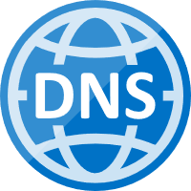

Container groups
Container group
80
Container
Web
DNS label
1433
IP address
Container
Azure Files
Notes:
Let’s examine the role of container group in Container Instances.
Container group is the top-level resource in Container Instances. A container group is a collection of containers that get scheduled on the same host machine. The containers in a container group share a lifecycle, resources, local network, and storage volumes.
This example of a container group:
Is scheduled on a single host machine.
Is assigned a DNS name label.
Exposes a single public IP address, with one exposed port.
Consists of two containers. One container listens on port 80, while the other listens on port 1433.
Includes two Azure File shares as volume mounts, and each container mounts one of the shares locally.

Slide 47
Container Instances features
Feature | Description
Fast startup times | Containers can start in seconds without the need to provision and manage VMs
Public IP connectivity and DNS name | Containers can be directly exposed to the internet with an IP address and a fully qualified domain name (FQDN)
Hypervisor-level security | Container applications are as isolated in a container as they would be in a VM
Custom sizes | Container nodes can be scaled dynamically to match actual resource demands for an application
Persistent storage | Containers support direct mounting of Azure Files shares
Linux and Windows containers | The same API is used to schedule both Linux and Windows containers
Co-scheduled groups | Container Instances supports scheduling of multicontainer groups that share host machine resources
Virtual network deployment | Container Instances can be deployed into an Azure virtual network
Notes:
Fast startup times
Containers offer significant startup benefits over virtual machines. Container Instances can start containers in Azure in seconds, without the need to provision and manage VMs.
Public IP connectivity and DNS name
Container Instances enables exposing your containers directly to the internet with an IP address and a fully qualified domain name (FQDN). When you create a container instance, you can specify a custom DNS name label so your application is reachable at customlabel.azureregion.azurecontainer.io.
Hypervisor-level security
Historically, containers have offered application dependency isolation and resource governance but have not been considered sufficiently hardened for hostile multi-tenant usage. Container Instances guarantees your application is as isolated in a container as it would be in a VM.
Custom sizes
As demand for resources increases, the nodes of an AKS cluster can be scaled out to match. If resource demand drops, nodes can be removed by scaling in the cluster. AKS scale operations can be completed using the Azure portal or the Azure CLI.
For compute-intensive jobs such as machine learning, Container Instances can schedule Linux containers to use NVIDIA Tesla GPU resources.
Persistent storage
To retrieve and persist state with Container Instances, we offer direct mounting of Azure Files shares.
Linux and Windows containers
Container Instances can schedule both Windows and Linux containers with the same API. Simply specify the OS type when you create your container groups. Some features are currently restricted to Linux containers. While we work to bring feature parity to Windows containers, you can find current platform differences in Quotas and region availability for Container Instances.
Container Instances supports Windows images based on Long-Term Servicing Channel (LTSC) versions. Windows Semi-Annual Channel (SAC) releases like 1709 and 1803 are unsupported.
Co-scheduled groups
Container Instances supports scheduling of multi-container groups that share a host machine, local network, storage, and lifecycle. This enables you to combine your main application container with other supporting role containers, such as logging sidecars.
Virtual network deployment
Container Instances enables deployment of container instances into an Azure virtual network. By deploying container instances into a subnet within your virtual network, they can communicate securely with other resources in the virtual network, including those that are on premises (through VPN gateway or ExpressRoute).

Slide 48
Docker terminology
Container
A standardized "unit of software" that contains everything required for an application to run
Container Image
A template that can be used to create one or more containers
Build
The process of creating a container image using a set of instructions
Pull
The process of downloading a container image from a container registry
Push
The process of uploading a container image to a container registry
Dockerfile
A text file that contains instructions required to build a Docker image.
Notes:
You should be familiar with the following key terms before using Docker and Container Instances to create, build, and test containers:
Container: This is an instance of a Docker image. It represents the execution of a single application, process, or service. It consists of the contents of a Docker image, an execution environment, and a standard set of instructions. When scaling a service, you create multiple instances of a container from the same image. Or a batch job can create multiple containers from the same image, passing different parameters to each instance.
Container image: This refers to a package with all the dependencies and information required to create a container. The dependencies include frameworks and the deployment and execution configuration that a container runtime uses. Usually, an image derives from multiple base images that are layers stacked on top of each other to form the container's file system. An image is immutable once it has been created.
Build: This refers to the action of building a container image based on the information and context provided by its Dockerfile, plus additional files in the folder where the image is built. You can build images by using the Docker docker build command.
Pull: This refers to the process of downloading a container image from a container registry.
Push: This refers to the process of uploading a container image to a container registry.
Dockerfile: This refers to a text file that contains instructions on how to build a Docker image. It's like a batch script; the first line states the base image, followed by instructions to install required programs, copy files, and so on until you get the working environment you need.

Slide 49
Create a container for deployment to Container Instances
FROM node:8.9.3-alpine
RUN mkdir -p /usr/src/app
COPY ./app/ /usr/src/app/
WORKDIR /usr/src/app
RUN npm install
CMD node /usr/src/app/index.js
Notes:
UPDATED SLIDE
The sample application in this tutorial is a simple web app built in Node.js. The application serves a static HTML page, and you can use Git to clone the sample application's repository:
git clone https://github.com/Azure-Samples/aci-helloworld.git
The Dockerfile for an application shows how the container is built.
It starts from an official Node.js image based on Alpine Linux, a small distribution that is well suited for use with containers. It then copies the application files into the container, installs dependencies by using the Node Package Manager, and finally, starts the application.

Slide 50
Build a container prior to Container Instances deployment
# Build your container
docker build ./aci-helloworld -t aci-tutorial-app
# After building, use the following command to view your new container image
docker images
Path to build
Docker tag
Notes:
Use the docker build command to create the container image and tag it as aci-tutorial-app.
Output from the docker build command is similar to the following (truncated for readability):
$ docker build ./aci-helloworld -t aci-tutorial-app
Sending build context to Docker daemon 119.3kB
Step 1/6 : FROM node:8.9.3-alpine
8.9.3-alpine: Pulling from library/node
88286f41530e: Pull complete
84f3a4bf8410: Pull complete
d0d9b2214720: Pull complete
Digest: sha256:c73277ccc763752b42bb2400d1aaecb4e3d32e3a9dbedd0e49885c71bea07354
Status: Downloaded newer image for node:8.9.3-alpine
---> 90f5ee24bee2
...
Step 6/6 : CMD node /usr/src/app/index.js
---> Running in f4a1ea099eec
---> 6edad76d09e9
Removing intermediate container f4a1ea099eec
Successfully built 6edad76d09e9
Successfully tagged aci-tutorial-app:latest
Use the docker images command to examine the built image. Your newly built image should appear in the list:
$ docker images
REPOSITORY TAG IMAGE ID CREATED SIZE
aci-tutorial-app latest 5c745774dfa9 39 seconds ago 68.1 MB

Slide 51
Test the container prior to Container Instances deployment
# Run your container locally
docker run -d -p 8080:80 aci-tutorial-app
# View running containers
docker container ls -a
Notes:
UPDATED SLIDE
Before you deploy the container to Container Instances, use docker run to run it locally and confirm that it works. The -d switch lets the container run in the background, while -p allows you to map an arbitrary port on your computer to port 80 in the container.
Output from the docker run command displays the running container's ID if the command was successful:
$ docker run -d -p 8080:80 aci-tutorial-app
A2e3e4435db58ab0c664ce521854c2e1a1bda88c9cf2fcff46aedf48df86cccf

Slide 52
Demo: Create a container for deployment to Container Instances
Notes:
Container Instances enables deployment of Docker containers onto Azure infrastructure without provisioning any virtual machines or adopting a higher-level service. In this tutorial, you package a small Node.js web application into a container image that can be run by using Container Instances.
This revision of the course does not ship with demo instructions. For each demo, you will be given a list of specific tasks you should demonstrate to your students. The flow, content and structure of your demo is left to you to decide as an instructor.
In this demo, you should show students how to:
Package an existing application into a Docker container image

Slide 53
Deploy a container to Container Instances
# Get name of container registry login server
az acr show --name <acrName> --query loginServer
# Get container registry password
az acr credential show --name <acrName> --query "passwords[0].value"
# Deploy container
az container create --resource-group myResourceGroup --name aci-tutorial-app --image <acrLoginServer>/aci-tutorial-app:v1 --cpu 1 --memory 1 --registry-login-server <acrLoginServer> --registry-username <acrName> --registry-password <acrPassword> --dns-name-label <aciDnsLabel> --ports 80
Notes:
When you deploy an image that's hosted in a private container registry, you must supply the registry's credentials.
First, get the full name of the container registry login server (replace <acrName> with the name of your registry).
Next, get the container registry password.
Now, use the az container create command to deploy the container. Replace <acrLoginServer> and <acrPassword> with the values that you obtained from the previous two commands. Replace <acrName> with the name of your container registry and <aciDnsLabel> with desired DNS name.

Slide 54
Verify a deployed container in Container Instances
# Verify deployment progress
az container show --resource-group myResourceGroup --name aci-tutorial-app --query provisioningState
# View application URL
az container show --resource-group myResourceGroup --name aci-tutorial-app --query ipAddress.fqdn
# View container logs
az container logs --resource-group myResourceGroup --name aci-tutorial-app
Notes:
UPDATED SLIDE
Example container log output:
$ az container logs --resource-group myResourceGroup --name aci-tutorial-app
listening on port 80
::ffff:10.240.0.4 - - [21/Jul/2017:06:00:02 +0000] "GET / HTTP/1.1" 200 1663 "-" "Mozilla/5.0 (Macintosh; Intel Mac OS X 10_12_5) AppleWebKit/537.36 (KHTML, like Gecko) Chrome/59.0.3071.115 Safari/537.36"
::ffff:10.240.0.4 - - [21/Jul/2017:06:00:02 +0000] "GET /favicon.ico HTTP/1.1" 404 150 "http://aci-demo.eastus.azurecontainer.io/" "Mozilla/5.0 (Macintosh; Intel Mac OS X 10_12_5) AppleWebKit/537.36 (KHTML, like Gecko) Chrome/59.0.3071.115 Safari/537.36“

Slide 55
Demo: Deploy a container to Container Instances
Notes:
In the last demo, a container image was created and pushed to the Container Registry. Now, you will deploy the container to Container Instances.
This revision of the course does not ship with demo instructions. For each demo, you will be given a list of specific tasks you should demonstrate to your students. The flow, content and structure of your demo is left to you to decide as an instructor.
In this demo, you should show students how to:
Deploy a container image to Container Instances by using the Portal.
Use the Azure CLI to deploy a container instance by using an image in Container Registry.

Slide 56
Virtual kubelet
A shim layer with a pseudo-kubelet implementation
You can use other services for your individual container instances
Supported by an ecosystem of providers:
Azure Batch
Container Instances
Alibaba Cloud Elastic Container Instance (ECI)
AWS Fargate
Kubernetes Container Runtime Interface (CRI)
Huawei Cloud Container Instance (CCI)
HashiCorp Nomad
OpenStack Zun
Notes:
When implementing a Kubernetes application, you may wish to deploy containers to services other than your Kubernetes cluster.
Virtual kubelet is an open-source implementation of a kubelet that allows you to use other services to back your Kubernetes cluster as opposed to the built-in nodes.
A virtual kubelet provides a shim layer with a pseudo-kubelet implementation enabling you to use other services for your individual instances, such as:
Azure Batch
Container Instances
Alibaba Cloud Elastic Container Instance (ECI)
AWS Fargate
Kubernetes Container Runtime Interface (CRI)
Huawei Cloud Container Instance (CCI)
HashiCorp Nomad
OpenStack Zun

Slide 57


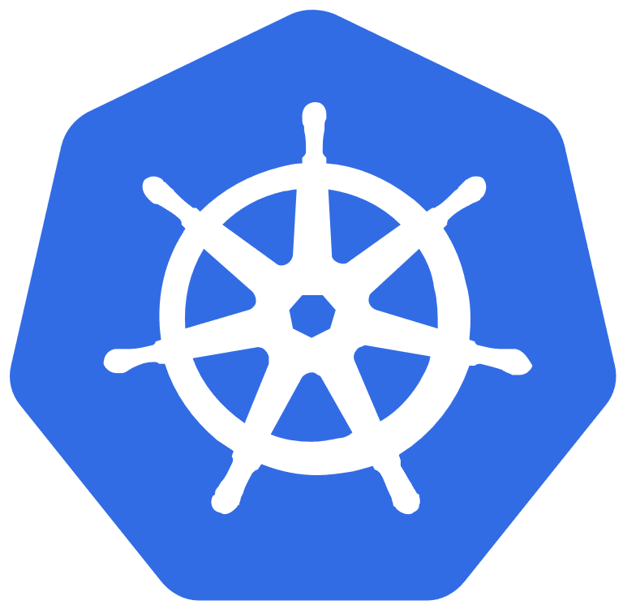
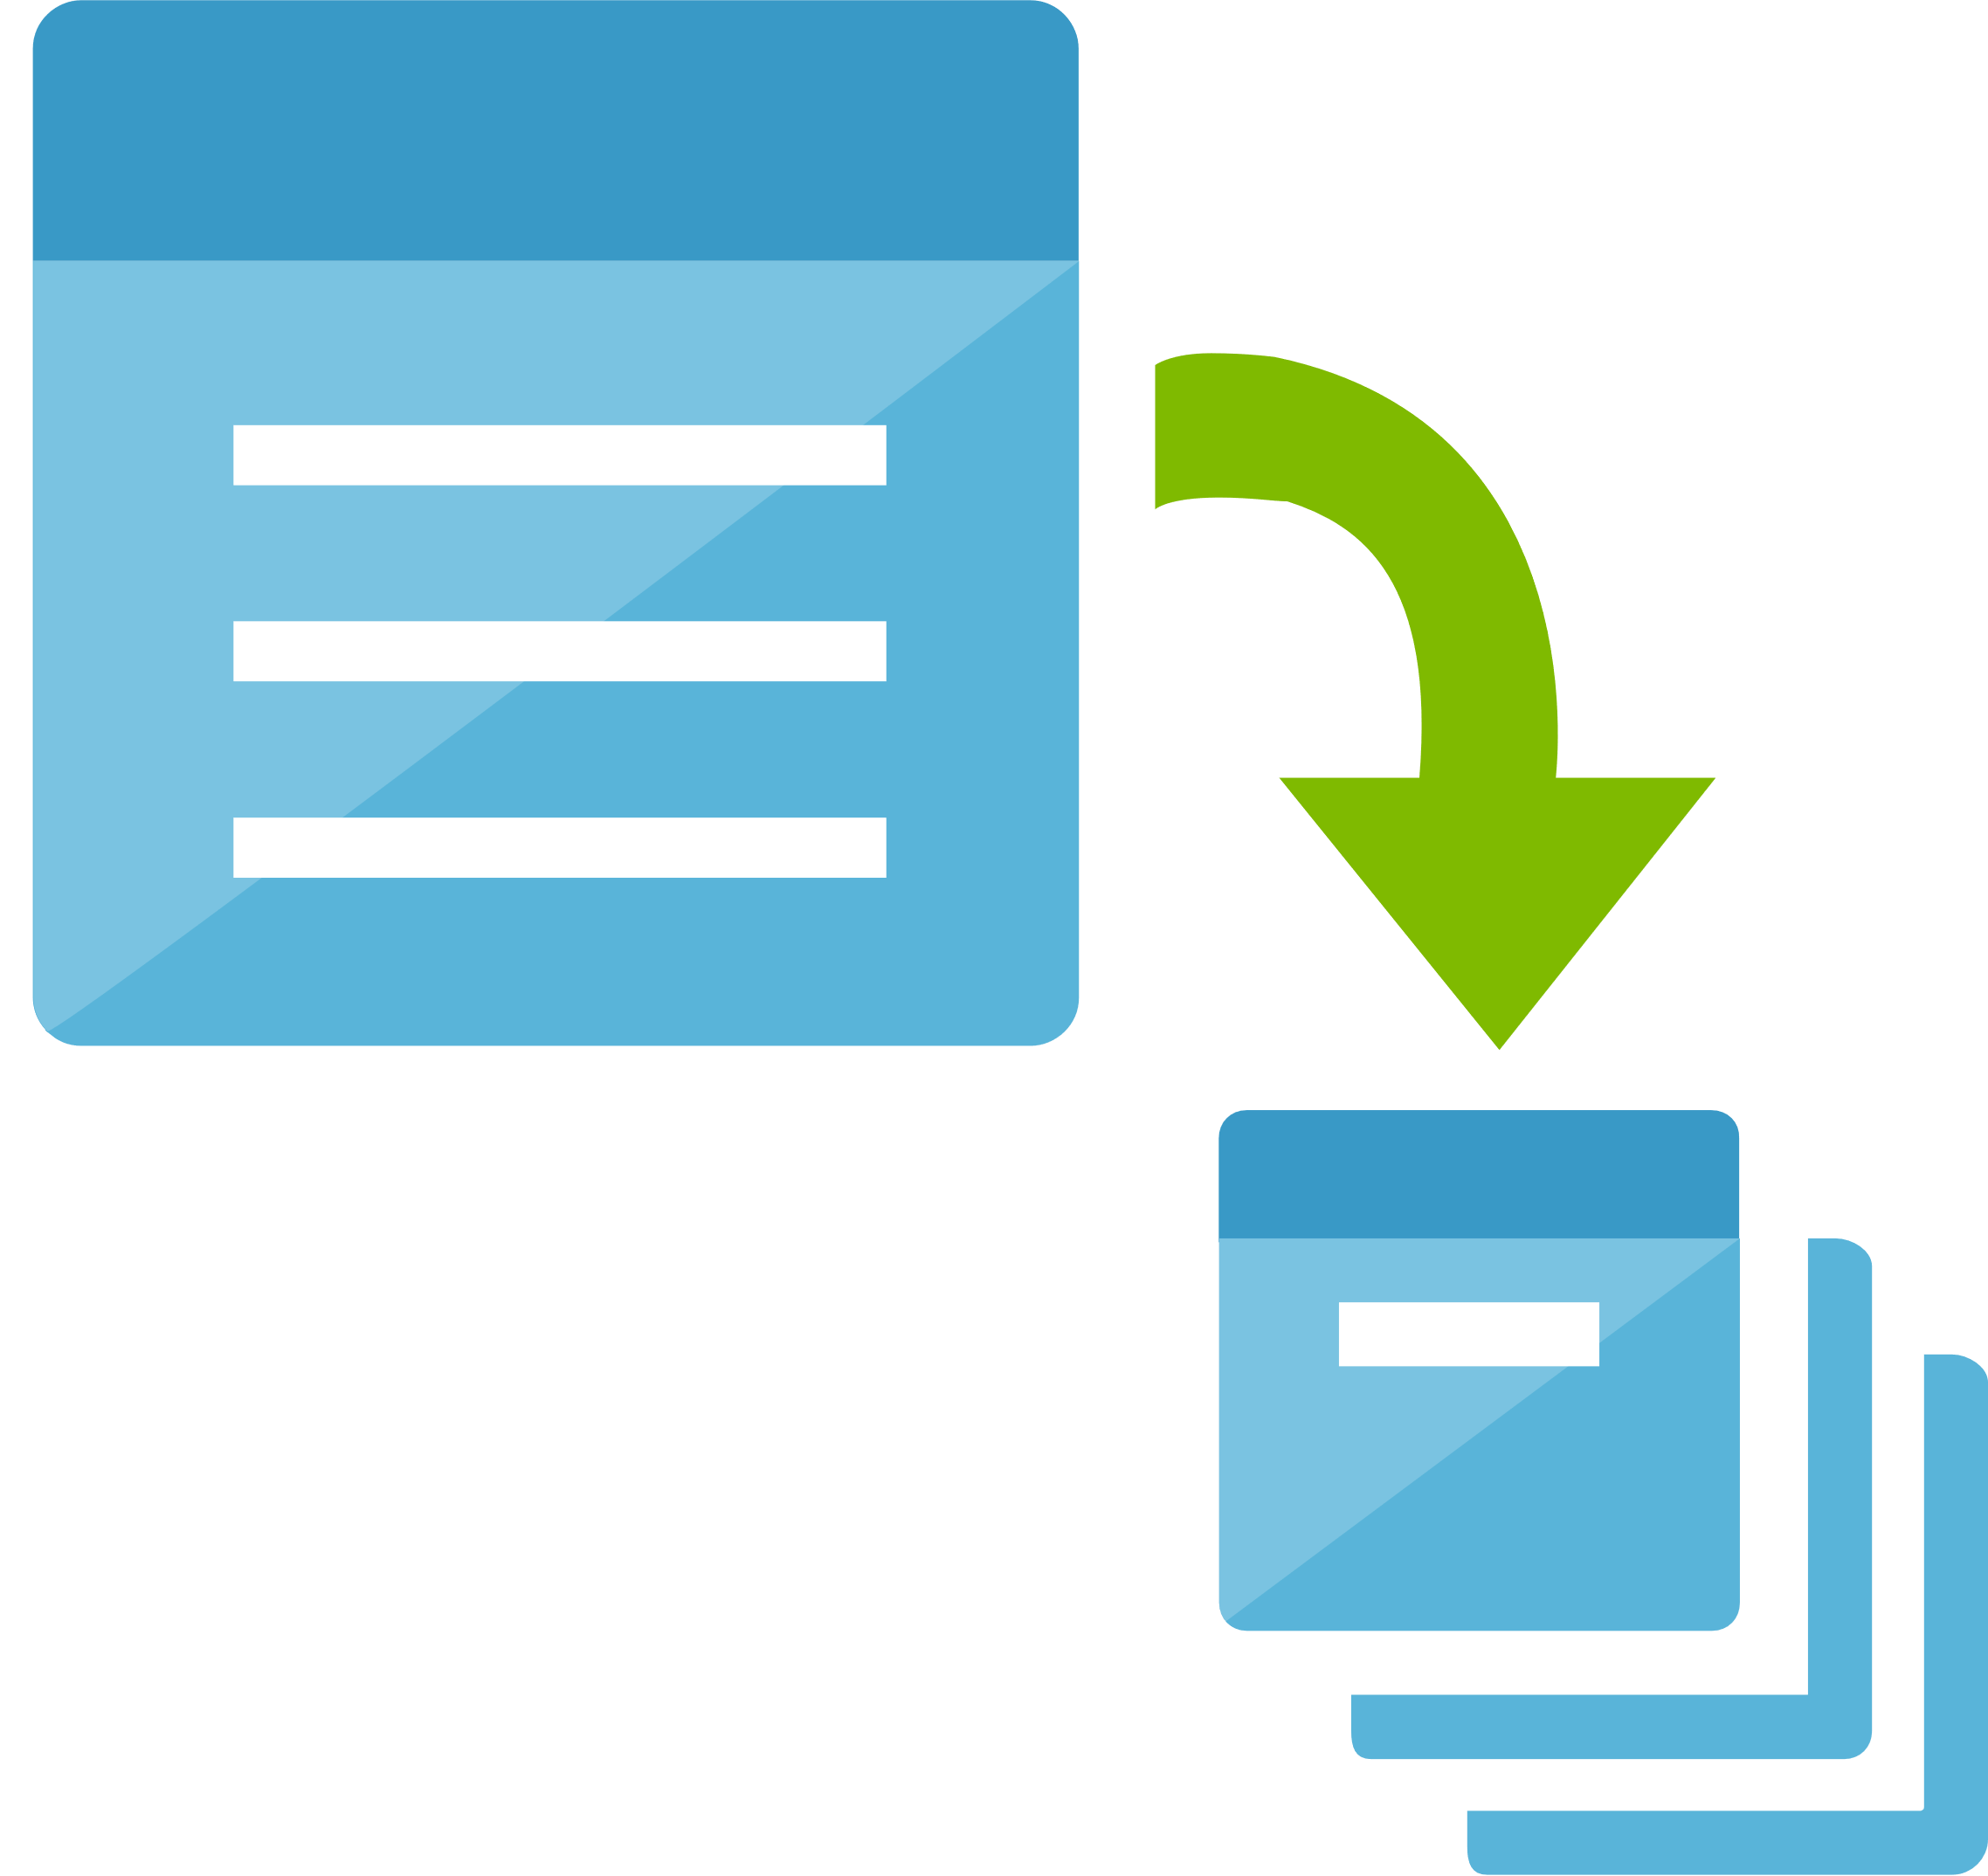
Using virtual Kubelet
Container Instances
Node
virtual Kubelet
virtual Kubelet
Other
Node
virtual Kubelet
Node
Kubernetes cluster
Azure Batch
Notes:
Let’s examine how a virtual Kubelet works.
In this example of a Kubernetes cluster, virtual kubelet is used to allow us to back our Kubernetes cluster with services such as Container Instances and Azure Batch. These services then host our individual nodes on behalf of the cluster.

Slide 58
Implement an application using virtual kubelet
# Install Virtual Kubelet connector
az aks install-connector --resource-group myAKSCluster --name myAKSCluster --connector-name virtual-kubelet --os-type Both
Notes:
When using the Virtual Kubelet provider for Container Instances, both Linux and Windows containers can be scheduled on a container instance as if it is a standard Kubernetes node. This configuration allows you to take advantage of both the capabilities of Kubernetes and the management value and cost benefit of container instances.

Slide 59
Command arguments
Arguments for aks install-connector command:
Argument | Description | Required
--connector-name | Name of the Container Instances connector. | Yes
--name | Name of the managed cluster. | Yes
--resource-group | Name of resource group. | Yes
--os-type | Container instances operating system type. Allowed values: Both, Linux, Windows. Default: Linux. | No
--aci-resource-group | The resource group in which to create the Container Instances container groups. | No
--location | The location to create the Container Instances container groups. | No
--service-principal | Service principal used for authentication to Azure APIs. | No
--client-secret | Secret associated with the service principal. | No
--chart-url | URL of a Helm chart that installs Container Instances connector. | No
--image-tag | The image tag of the virtual kubelet container image. | No
Notes:
Use the az aks install-connector command to install Virtual Kubelet. The example deploys both the Linux and Windows connector.

Slide 60
Virtual kubelet specification
apiVersion: apps/v1beta1
kind: Deployment
metadata:
name: aci-helloworld
spec:
replicas: 1
template:
metadata:
labels:
app: aci-helloworld
spec:
containers:
- name: aci-helloworld
image: microsoft/aci-helloworld
ports:
- containerPort: 80
nodeSelector:
kubernetes.io/hostname: virtual-kubelet-virtual-kubelet-linux
tolerations:
- key: azure.com/aci
effect: NoSchedule
Notes:
This file is a Kubelet specification file that describes the container-based application that should run using the virtual Kubelet. In this example, we are using the Linux-based aci-helloworld container. We could opt to use a Windows-based container such as nanoserver-iis instead.

Slide 61
Deploying an application by using virtual kubelet
# Validate that Virtual Kubelet has been installed
kubectl get nodes
# Run application (Windos or Linux)
kubectl create -f virtual-kubelet.yaml
# View pods with the scheduled node
kubectl get pods -o wide
Notes:
To validate that Virtual Kubelet has been installed, return a list of Kubernetes nodes by using the kubectl get nodes command.
Run the application with the kubectl create command.
Use the kubectl get pods command with the -o wide argument to output a list of pods with the scheduled node. Notice that the nanoserver-iis pod has been scheduled on the virtual-kubelet-virtual-kubelet-win node.

Slide 62
Demo: Implement an application by using Virtual Kubelet
Notes:
When using the Virtual Kubelet provider for Container Instances, both Linux and Windows containers can be scheduled on a container instance as if it is a standard Kubernetes node. This configuration allows you to take advantage of both the capabilities of Kubernetes and the management value and cost benefit of container instances.
Note: Virtual Kubelet is an experimental open-source project and should be used as such. To contribute, file issues, and read more about Virtual Kubelet, examine the Virtual Kubelet GitHub project.
This revision of the course does not ship with demo instructions. For each demo, you will be given a list of specific tasks you should demonstrate to your students. The flow, content and structure of your demo is left to you to decide as an instructor.
In this demo, you should show students how to:
Validate the Virtual Kubelet provider for Container Instances
Deploy Linux and Windows containers to Container Instances using a YAML file

Slide 63
Helm
Uses charts to define complex applications
Charts contain containers that will be used in the application
Charts also contain configuration for storage and connectivity
Uses a cluster-side service (Tiller) to manage deployments
Notes:
You are already aware that Helm makes it easier to manage applications in Kubernetes.
Like Linux package managers, such as APT and Yum, Helm is used to manage Kubernetes charts, which are packages of preconfigured Kubernetes resources.
You’ll learn how Helm charts are deployed next.

Slide 64

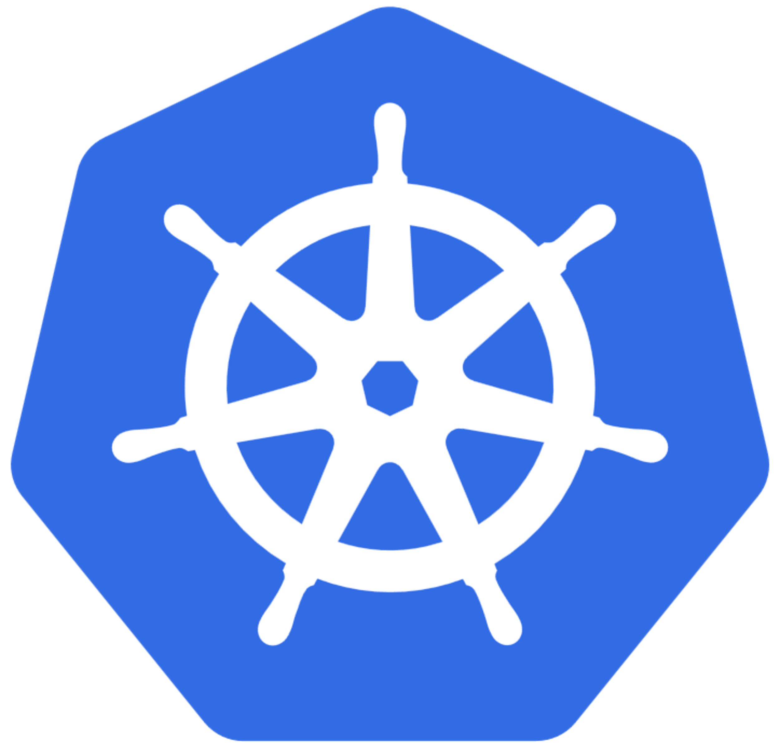
Initializing Helm
Kubernetes
Nodes
helm init
Tiller
helm install
Notes:
You can initialize Helm on your Kubernetes cluster by installing a Tiller.
To deploy a Tiller into your Kubernetes cluster, use the helm init command. This command installs a Tiller if it's not already installed and makes sure the version of the Helm CLI and the Tiller match.
Then you can deploy a helm chart using the helm install command. The Tiller will manage the deployment within your Kubernetes cluster.

Slide 65
Example of a Helm chart
Chart.yaml
templates/alpine-pod.yaml
name: alpine
description: Deploy a basic Alpine Linux pod
version: 0.1.0
home: https://github.com/helm/helm
sources:
- https://github.com/helm/helm
appVersion: 3.3
apiVersion: v1
kind: Pod
metadata:
name: {{ template "alpine.fullname" . }}
spec:
restartPolicy: {{ .Values.restartPolicy }}
containers:
- name: waiter
image: "{{ .Values.image.repo }}:latest"
imagePullPolicy: {{ .Values.image.policy }}
command: ["/bin/sleep", "9000"]
values.yaml
image:
repo: alpine
policy: IfNotPresent
restartPolicy: Never
Notes:
This is an example (with a few files omitted) of a Helm chart that runs a single pod running Alpine Linux.
The Chart.yaml file contains metadata about the Helm chart that is used to describe the chart.
The values.yaml file defines the default values that are set (but can be overridden) when this chart is installed.
The alpine-pod.yaml file defines the actual deployment to the pod which will deploy the alpine:latest image from Docker Hub.

Slide 66

Lab: Deploying compute workloads by using images and containers
Notes:
Your organization is seeking a way to automatically create virtual machines (VMs) to run tasks and immediately terminate. You are tasked with evaluating multiple compute services in Microsoft Azure and determining which service can help you automatically create virtualized machines and install custom software on those machines. As a proof of concept, you have decided to try to create VMs from VHD images and container images so that you can compare the two solutions. To keep your proof of concept simple, you will create a special “IP check” application, written in .NET Core, that you will automatically deploy to your machines. Your proof of concept will evaluate the Container Instances and Azure Virtual Machines services.

Slide 67
Lab login information
Virtual Machine
AZ203-SEA-DEV
Username: Admin
Password: Pa55w.rd
Notes:
Ensure that your students are signed in to their Windows 10 virtual machine by using the following credentials:
Username: Admin
Password: Pa55w.rd

Slide 68
Review
Azure Kubernetes Service
Deploy an AKS cluster
Publish a container image to Azure Container Registry
Create and run container images in Azure Container Instances
Lab: Deploying compute workloads by using images and containers
Notes:
These are the topics that we discussed in this module.

